Slide 1
Lecture 2
Network
Models
Copyright © The McGraw-Hill Companies, Inc. Permission required for reproduction or display.

Slide 2
Chapter 2: Outline
2.1 Protocol Layering
2.2 TCP/IP Protocol Suite
Notes:
1.#

Slide 3
    2-1 PROTOCOL LAYERING
A word we hear all the time when we talk about the Internet is protocol. A protocol defines the rules that both the sender and receiver and all intermediate devices need to follow to be able to communicate effectively. When communication is simple, we may need only one simple protocol; when the communication is complex, we need a protocol at each layer, or protocol layering.
2.<number>
Notes:
1.#

Slide 4
2.1.1 Scenarios
Let us develop two simple scenarios to better understand the need for protocol layering.
In the first scenario, communication is so simple that it can occur in only one layer.
In the second, the communication between Maria and Ann takes place in three layers.
2.<number>
Notes:
1.#

Slide 5
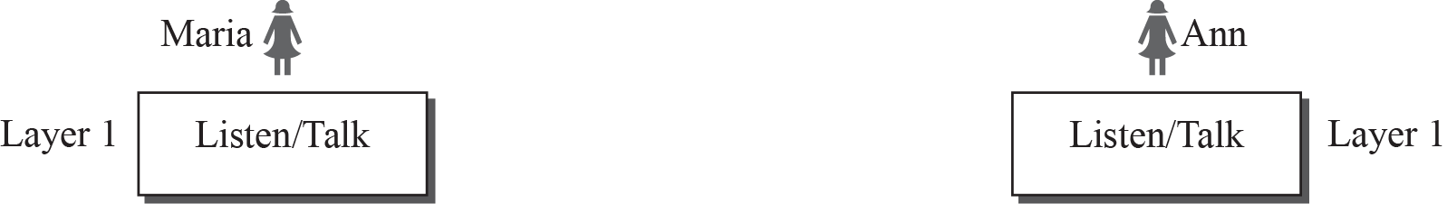
Figure 2.1: A single-layer protocol
2.<number>
Notes:
1.#

Slide 6
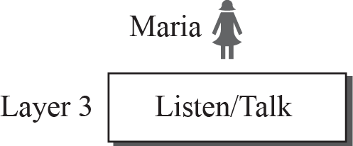
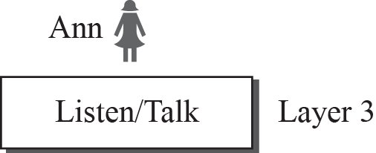
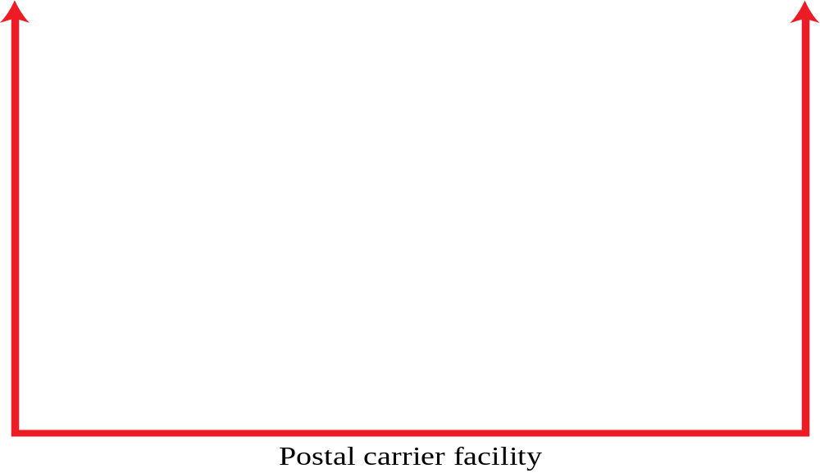


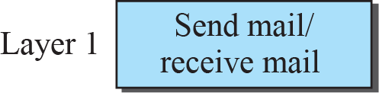
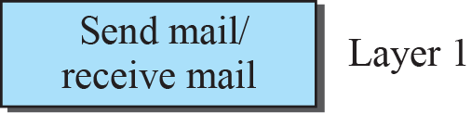
Figure 2.2: A three-layer protocol
2.<number>
Notes:
1.#

Slide 7
2.1.2 Principles of Protocol Layering
Let us discuss two principles of protocol layering.
The first principle dictates that if we want bidirectional communication, we need to make each layer so that it is able to perform two opposite tasks, one in each direction.
The second principle that we need to follow in protocol layering is that the two objects under each layer at both sites should be identical.
2.<number>
Notes:
1.#

Slide 8
Standards/Standards Bodies
Why do we have standards?
  market driver
  cost driver
  interoperability between vendors/ dissimilar architectures
Disadvantages of standards?
  tend to freeze technology
  redundancy, overkill
Types of standards
  Voluntary (driven by de facto use, ubiquity)
  Regulatory
  Regulatory use of voluntary standards
Notes:
Protocols and the TCP/IP Suite
Chapter 2

Slide 9
Standards/Standards Bodies
The Internet Society
  Internet Architecture Board (IAB)
    defines overall architecture of the Internet
    provides broad guidance for IETF
  Internet Engineering Steering Group (IESG)
    provides technical management of IETF and the Internet standards process
  Internet Engineering Task Force (IETF)
    designs and develops Internet protocols
    charters standards working groups
    publishes RFCs, with approval of IESG
    Eight areas defined: General, Applications, Internet, Operations & Management, Routing, Security, Transport, User Services
Notes:
Protocols and the TCP/IP Suite
Chapter 2

Slide 10
Internet RFC Process
Internet Draft
Proposed Standard
Best Current Practice
Experimental
Informational
Draft Standard
Internet Standard
Historic
Notes:
Protocols and the TCP/IP Suite
Chapter 2

Slide 11
Standards/Standards Bodies
International Telecommunications Union (ITU)
  United Nations agency
  Members are governments
  ITU-T (replaced CCITT) drives telecommunications standardization process
    organized as 14 study groups
    4-year cycle/study period for standards (but changing)
Notes:
Protocols and the TCP/IP Suite
Chapter 2

Slide 12
Standards/Standards Bodies
Institute of Electrical and Electronics Engineers, Inc (IEEE)
  LAN Standards: IEEE 802
  Subsequently ISO 8802
  currently organized into seventeen working groups (e.g. IEEE 802.3)
  IEEE 802.1 defines overall architecture and practices for LANs/MANs
Notes:
Protocols and the TCP/IP Suite
Chapter 2

Slide 13
The Need for a Protocol Architecture
Procedures to exchange data between devices can be complex
High degree of cooperation required between communicating systems
  destination addressing, path
  readiness to receive
  file formats, structure of data
  how commands are sent/received and acknowledged
  etc.
Notes:
Protocols and the TCP/IP Suite
Chapter 2

Slide 14
    2-2 TCP/IP PROTOCOL SUITE
A word we hear all the time when we talk about the Internet is protocol. A protocol defines the rules that both the sender and receiver and all intermediate devices need to follow to be able to communicate effectively. When communication is simple, we may need only one simple protocol; when the communication is complex, we need a protocol at each layer, or protocol layering.
2.<number>
Notes:
1.#

Slide 15
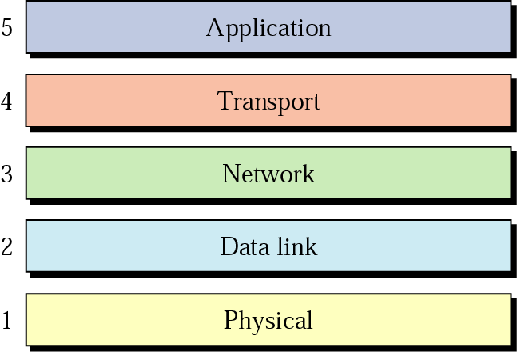
2.2.1 TCP/IP Layered
The layers in the TCP/IP protocol suite is made of five layers: physical, data link, network, transport, and application.
Layer: A grouping of related tasks involving the transfer of information .Each layer addresses an essential networking tasks
2.<number>

Slide 16
2.2.1 Layered Architecture
To show how the layers in the TCP/IP protocol suite are involved in communication between two hosts, we assume that we want to use the suite in a small internet made up of three LANs (links), each with a link-layer switch. We also assume that the links are connected by one router, as shown in Figure 2.5.
2.<number>
Notes:
1.#

Slide 17
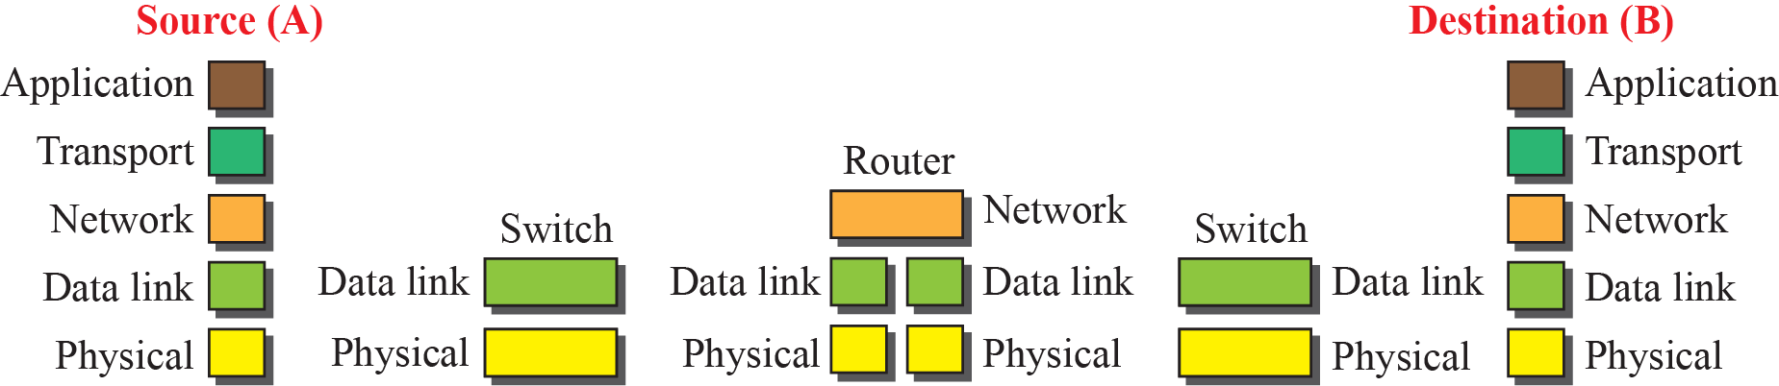

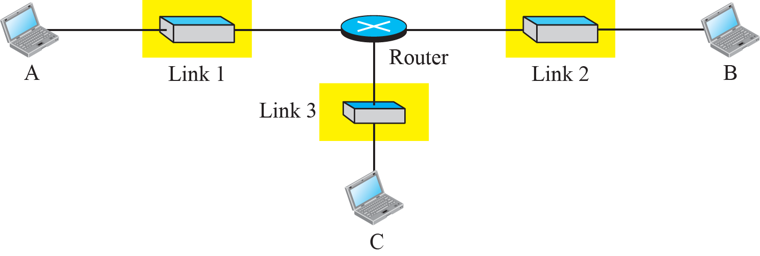
Figure 2.5: Communication through an internet
2.<number>
Notes:
1.#

Slide 18
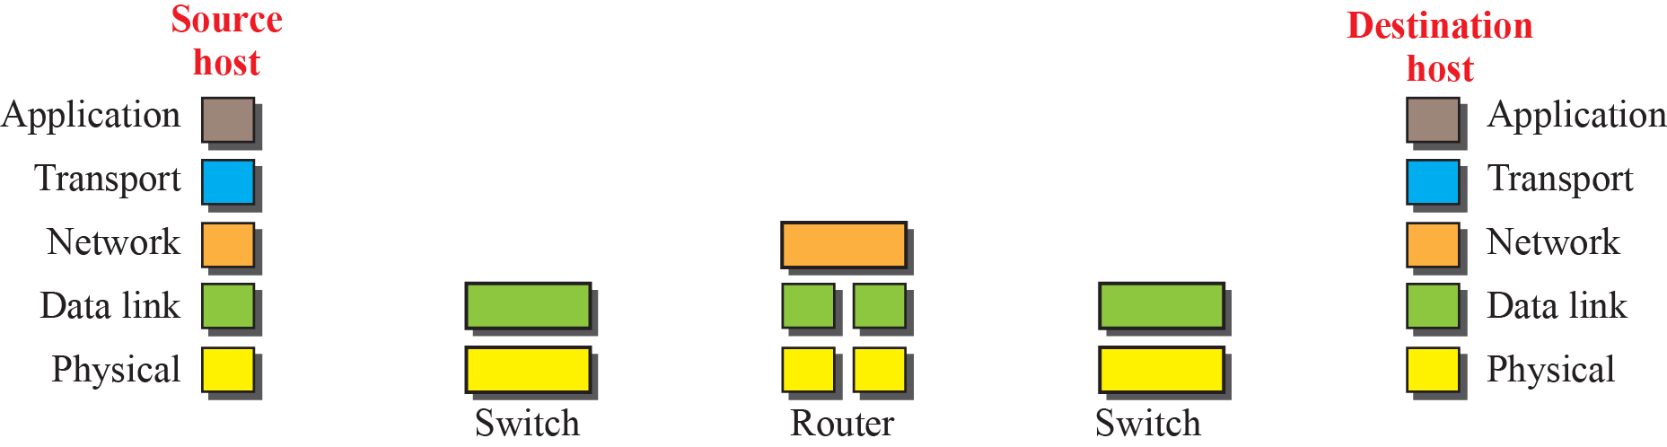
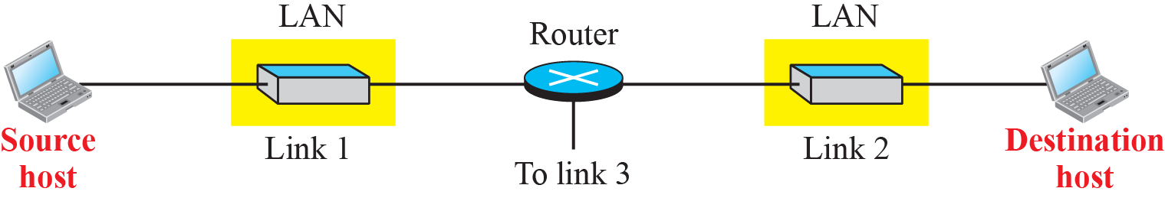
2.2.2 Layers in the TCP/IP Protocol Suite
To better understand the duties of each layer, we need to think about the logical connections between layers.
Logical connections
2.<number>
Notes:
1.#

Slide 19
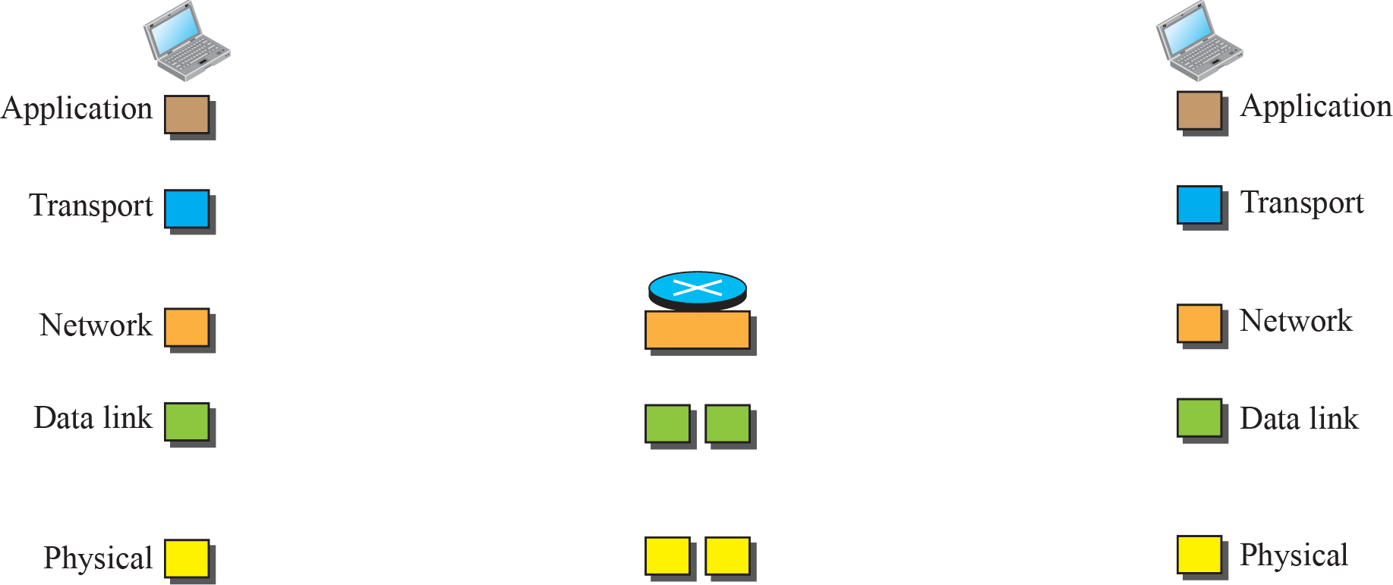
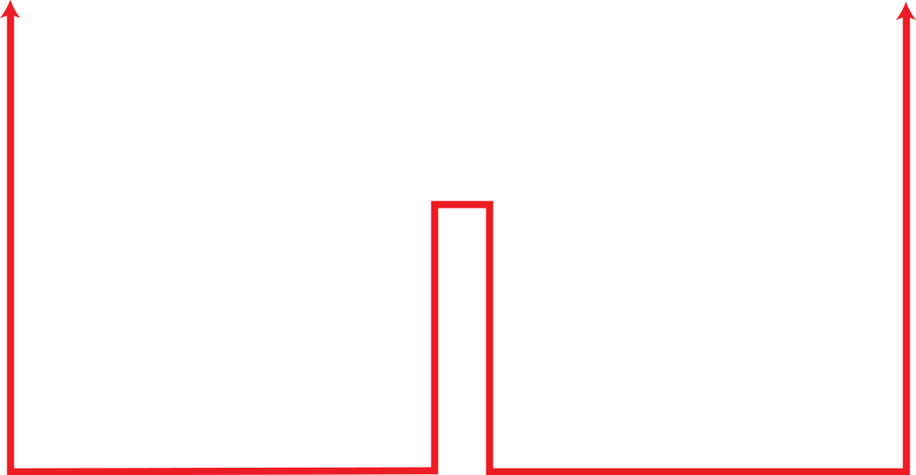
Figure 2.7: Identical objects in the TCP/IP protocol suite
Identical objects (messages)
Identical objects (segment or user datagram)
Identical objects (datagram)
Identical objects (datagram)
Identical objects (frame)
Identical objects (frame)
Identical objects (bits)
Identical objects (bits)
2.<number>
Notes:
1.#

Slide 20
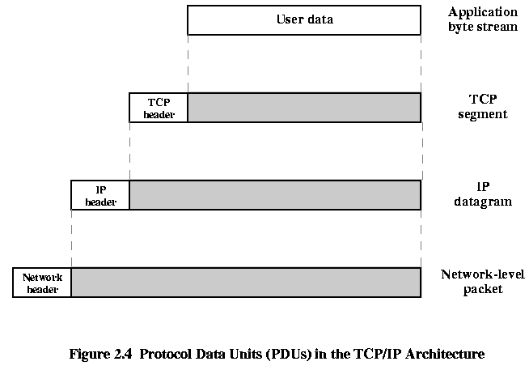
2.<number>

Slide 21
2.2.3 Description of Each Leyer
1. Physical layer
The physical layer is responsible for movements of individual bits from one hop (node) to the next.
Transmission Media is another hidden layer under the Physical Layer
Notes:
1.#

Slide 22

Physical layer
2.<number>

Slide 23
2.2.3 Description of Each Leyer
2. Data Link Layer
The data link layer is responsible for moving
frames from one hop (node) to the next over the link.
The link can be Wired LAN/WAN or Wireless LAN/WAN.
Some protocols provides complete error detection and correction, some protocols provide only error correction.
At the Datalink layer addresses are called MAC Address.
2.<number>

Slide 24

Data link layer
2.<number>

Slide 25
Datalink Layer
Physical address (MAC)
known also as the MAC or link address
Is the address of a node as defined by its LAN or WAN
It is included in the frame used by data link layer (Header)
The MAC addresses are locally defined address
2.<number>

Slide 26
2.2.3 Description of Each Leyer
3. Network Layer
The network layer is responsible for the delivery of individual packets from the source host to the destination host across multiple network.
If two system are connected to the same link (network), no need for this layer.
The network layer also response for routing the packet.
IP is the main protocol of the network layer.
At the Network layer addresses are called IP Address.
2.<number>

Slide 27
Network Layer
Logical addressing (IP)
Network layer adds unique identifier ( IP or logical address) to the packet.
These unique identifier( as tel. no, each tel. has unique number) enable special devices called router to make sure the packet get to correct system.
IP addresses are necessary for universal communications that are independent of physical network.
Routing:
provide the routing mechanism for the router which route the packet to their final destination.
Routers : devices used when independent networks are connected to create an internetworking ( network of networks)
2.<number>

Slide 28
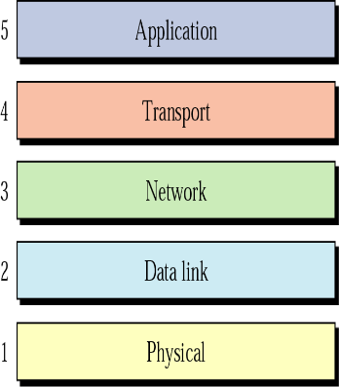

Network layer
2.<number>

Slide 29
2.2.3 Description of Each Leyer
4. Transport Layer (process to process delivery)
The transport layer is responsible for the delivery
of a message from one process to another.
At the Transport layer addresses are called Port Address.
TCP/IP model defines 3 protocols :
  TCP (Transmission Control Protocol )
  UDP (User Datagram Protocol)
  SCTP( Stream Control Transmission Protocol)
2.<number>

Slide 30


Transport layer
2.<number>

Slide 31
Transport Layer
Port addressing (Service-point addressing)
Computer often run several process ( running programs) at the same time, so the process to process delivery means delivery from a specific process on a computer to specific process to the other.
The transport layer header must include Port address
Port address: 16-bit addresses represented by decimal number range from 0-65535 to choose among multiple processes on the destination host
Destination port No is needed for delivery
Source port No is needed for replay.
2.<number>

Slide 32
Transport Layer
The transport layer can be either connection less or connection oriented
1. Connection oriented protocol (TCP)
Makes a connection with the transport layer at the destination machine first before delivering the packers.
When the connection established a sequence of packets from source to the destination can be sent one after another on the same path and in sequential order.
When all packets of message have been delivered, the connection is terminated
This makes the sending transport layer ensure that the message arrives at the receiving transport layer without error ( damage, loss or duplication
2.<number>

Slide 33
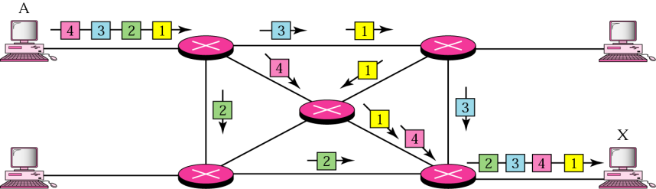
Transport Layer
2. Connection Less Protocol (UDP)
It sends the data, but does not establish and verify a connection between hosts before sending data.
Treats each packet independently, the packets in a message may or may not travel the same path to their destination.
2.<number>

Slide 34
2.2.3 Description of Each Leyer
5 . Application Layer
The application layer exchange messages between each other.
TCP/IP model defines the following protocols:
  FTP:File transfer protocol is used for transferring files from one host to another .
  Telnet: A service that enables users on the internet to log onto remote systems from their own host system.
  HTTP: Hyper text transfer protocol used for network file transfers in WWW environment
  SMTP: Simple mail transfer protocol used to send electronic mail on the internet.
2.<number>

Slide 35
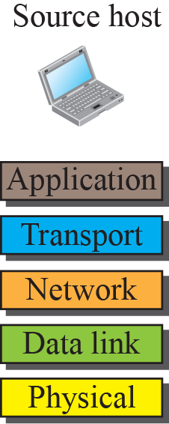
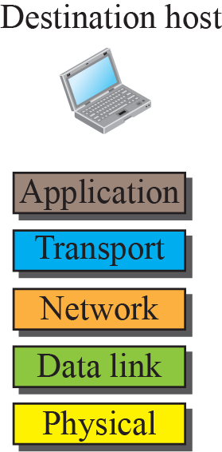

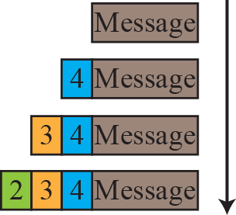
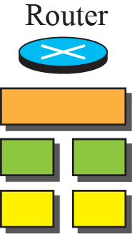
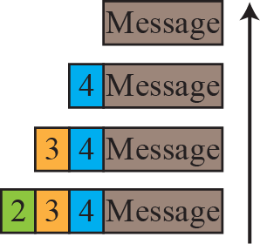
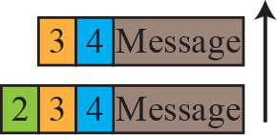
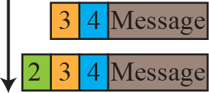
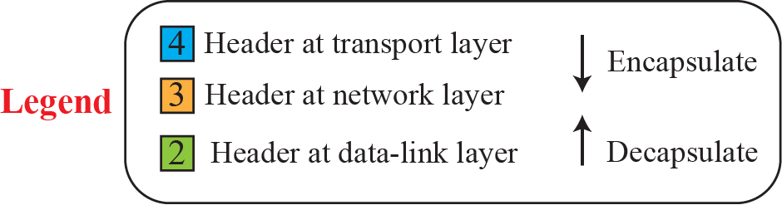
2.2.4 Encapsulation and Decapsulation
One of the important concepts in protocol layering in the Internet is encapsulation/ decapsulation.
2.<number>
Notes:
1.#

Slide 36

2.2.5 Addressing
Four levels of addresses are used in an internet employing the TCP/IP protocols
Examples for Specific addresses:
e-mail addresses ( Lhajr@yahoo.com) to define the recipient of an e-mail
URL addresses ( www.ksu.com) to find a document on the world wide web
The addresses get changed to the corresponding port and logical addresses by the sending computer
Logical address (IP) The physical addresses will change from hop to hop, but the logical addresses remain the same.
2.<number>

Slide 37
Protocol Data Units (PDU)
User data is passed from layer to layer
Control information is added/removed to/from user data at each layer
  Header (and sometimes trailer)
  each layer has a different header/trailer
Data + header + trailer = PDU (Protocol Data Unit)
  This is basically what we call packet
  each layer has a different PDU

Slide 38
Example2:
The following figure shows a part of an internet with two routers connecting three LANs. Each device (computer or router) has a pair of addresses (logical and physical) for each connection. In this case, each computer is connected to only one link and therefore has only one pair of addresses. Each router, however, is connected to three networks (only two are shown in the figure). So each router has three pairs of addresses, one for each connection.
2.<number>

Slide 39

Example2:
2.<number>

Slide 40

Relationship of layers and addresses in TCP/IP
2.<number>

Slide 41
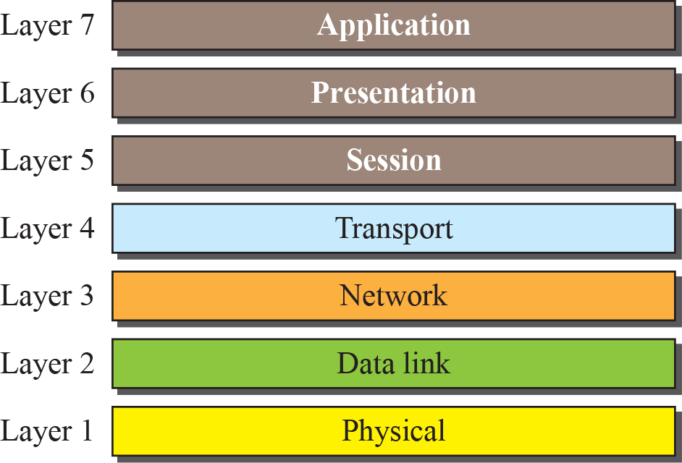
Figure 2.11: The OSI model
2.<number>
Notes:
1.#

Slide 42
TCP
Transmission Control Protocol
  end to end protocol
  Reliable connection = provides flow and error control
In TCP terms, a connection is a
  temporary association between entities in different systems
TCP PDU
  Called “TCP segment”
  Includes source and destination port
    Identify respective users (applications)
    pair of ports (together with the IP addresses) uniquely identify a connection; such an identification is necessary in order TCP to track segments between entities.

Slide 43
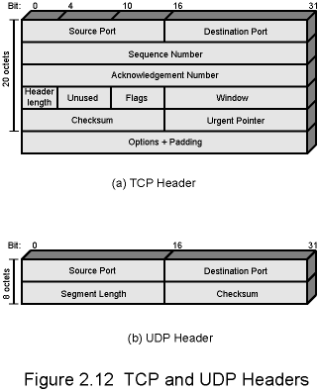
TCP Header

Slide 44
UDP
User Datagram Protocol
Alternative to TCP
  end-to-end protocol
Not guaranteed delivery
No preservation of sequence
No protection against duplication
Minimum overhead

Slide 45
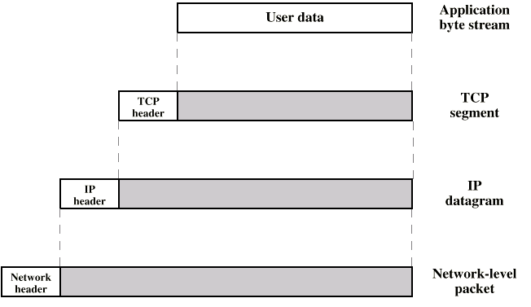
PDUs in TCP/IP
Dest. Port
Sequence number
Checksum
….
Dest. Address
Source address
….
Dest. Network Address
Priority info

Slide 46
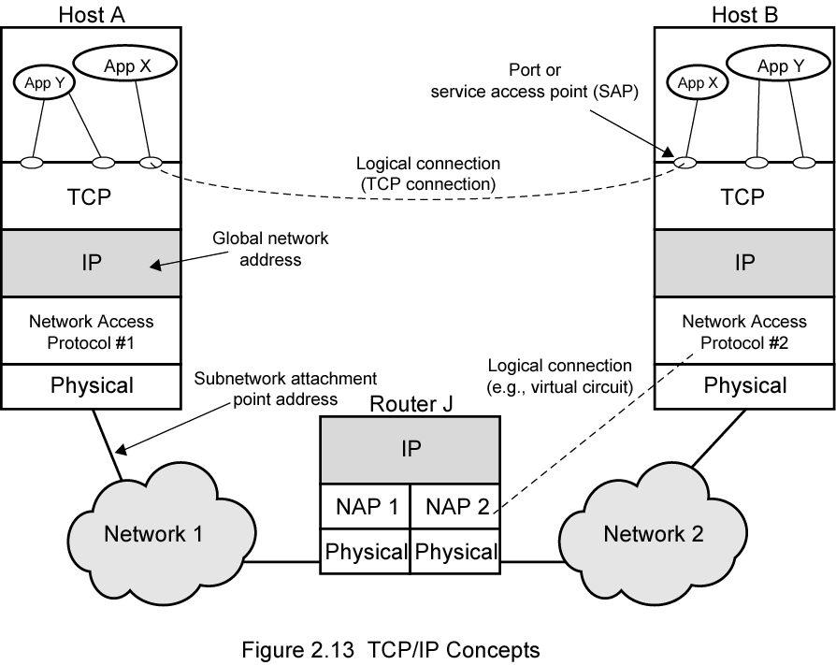
Operation of TCP and IP

Slide 47
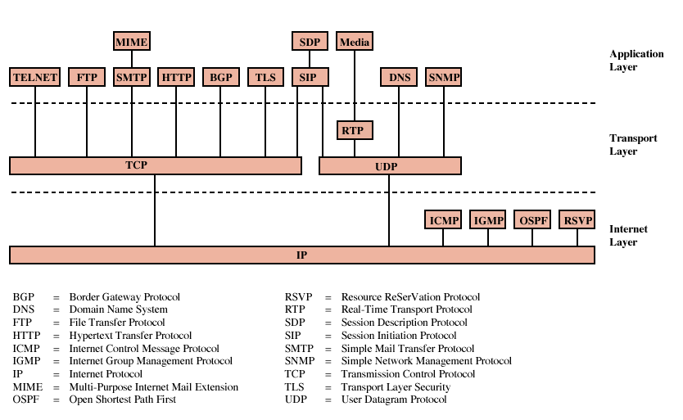
Some Protocols in TCP/IP Suite

Slide 48
Internetworking Terms
Communication network
Internet
Intranet
Subnetwork
End system
Intermediate system
Bridge
Router
Notes:
Protocols and the TCP/IP Suite
Chapter 2

Slide 49
Interconnected set of networks
  May be seemed as a large network
Each constituent network is a subnetwork
Entire configuration referred to as an internet
  not the Internet
    conceptually the same but by “internet” we do not mean a specific network
    the Internet is the most important example of an internet
2.<number>

Slide 50
Routers
Provide link between networks
Accommodate network differences:
  Addressing schemes
  Maximum packet sizes
  Hardware and software interfaces
  Network reliability
  Congestion/Traffic Management
Notes:
Protocols and the TCP/IP Suite
Chapter 2
Insert figures 2-7 – 2-10

Slide 51
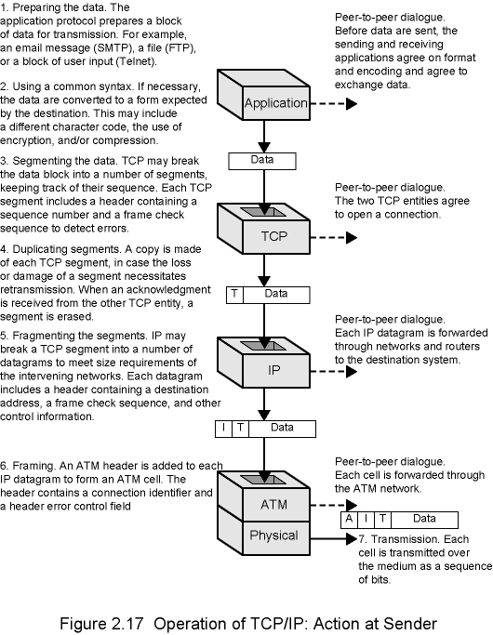
2.<number>

Slide 52
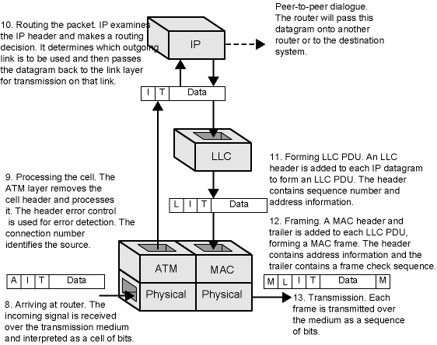
2.<number>

Slide 53
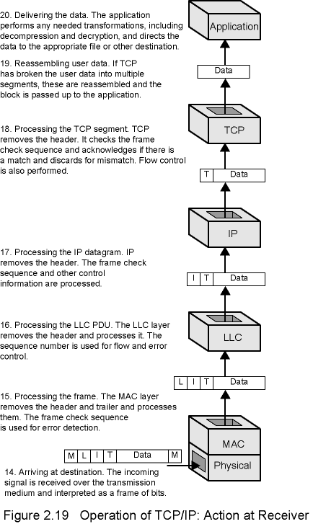
2.<number>

Slide 54
2.3.1 OSI versus TCP/IP
When we compare the two models, we find that two layers, session and presentation, are missing from the TCP/IP protocol suite. These two layers were not added to the TCP/IP protocol suite after the publication of the OSI model. The application layer in the suite is usually considered to be the combination of three layers in the OSI model, as shown in Figure 2.12.
2.<number>
Notes:
1.#

Slide 55
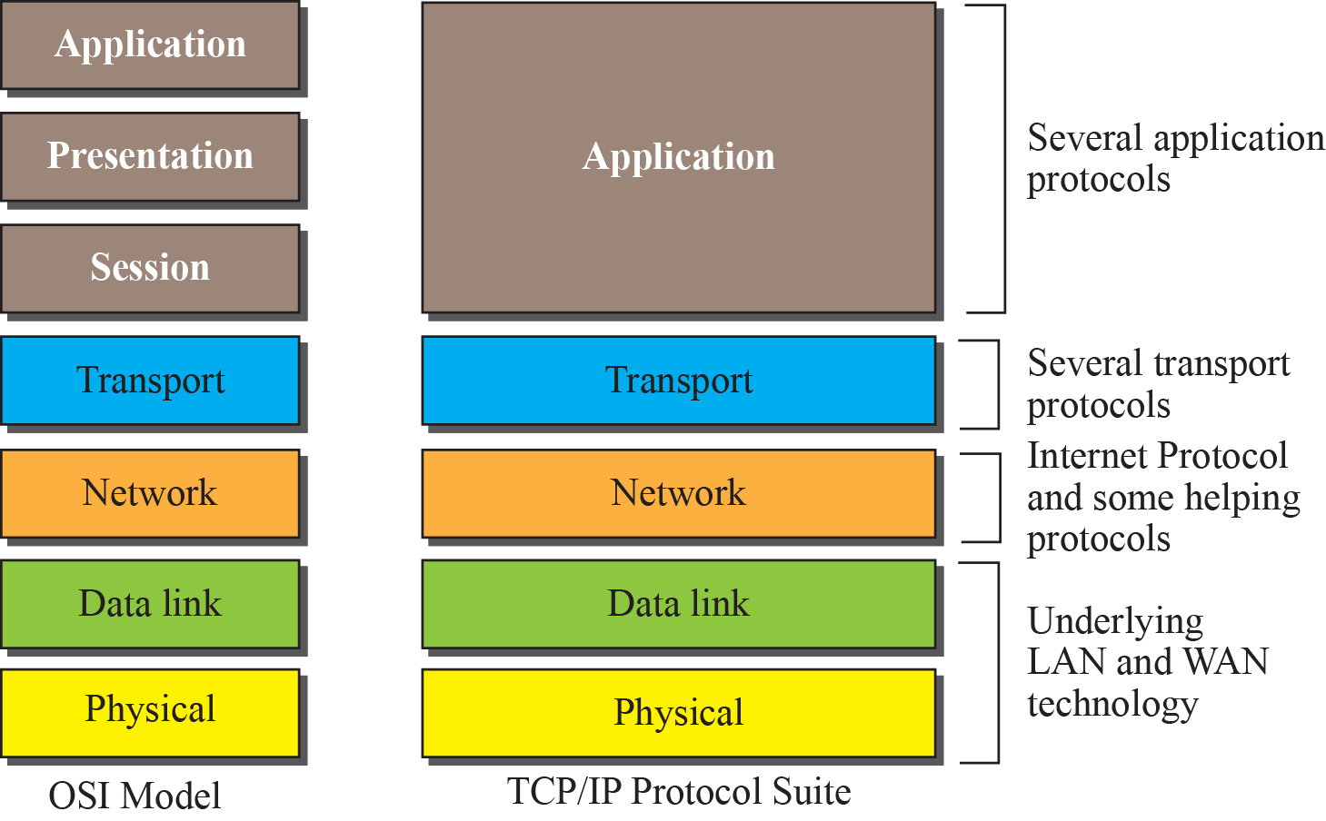
Figure 2.12: TCP/IP and OSI model
2.<number>
Notes:
1.#

